Slide 1
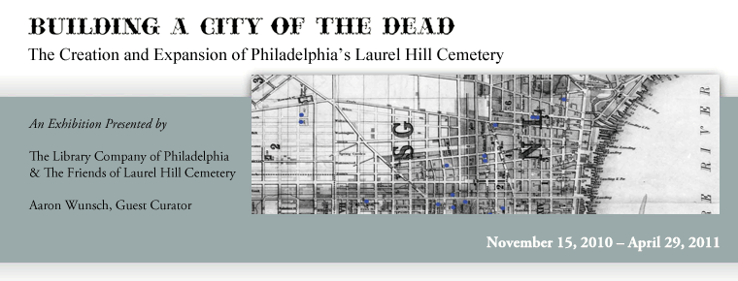

Slide 2
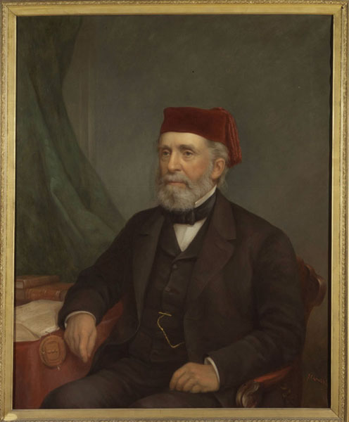
James Reid Lambdin, artist. John Jay Smith (ca. 1875).
John Jay Smith built his life and career around two institutions: the Library Company of Philadelphia and Laurel Hill Cemetery. A Quaker antiquarian and would-be litterateur, Smith had tried his hand at the drug and newspaper businesses before becoming Librarian in 1829. Over the following decades, he gained national recognition as an editor, publisher, horticulturist, and cemetery manager.

Slide 3
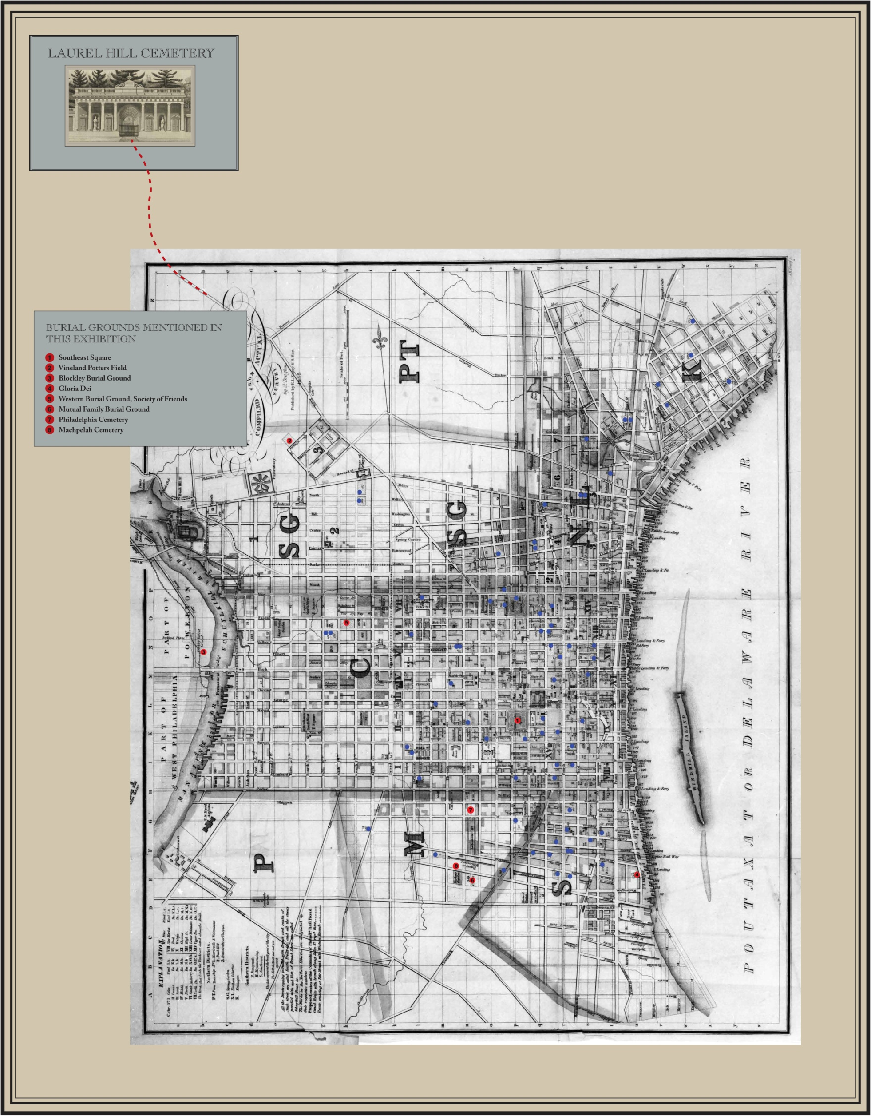

Slide 4
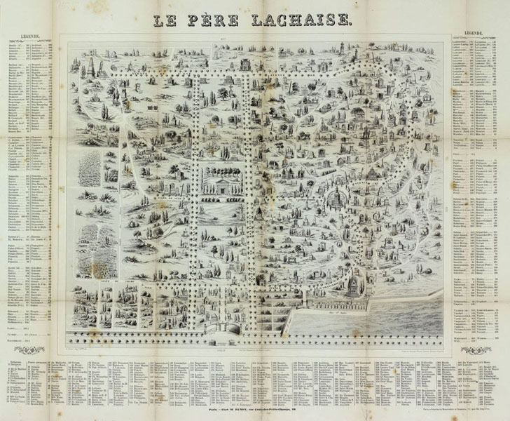
Le Père Lachaise. Paris: Henry, ca. 1850. The Historical Society of Pennsylvania.
By the late 18th century, Paris's aging graveyards were overflowing. A novel application of naturalistic landscape design to an extra-urban cemetery, Père Lachaise won admirers at home and abroad. Among them was former Philadelphia Mayor Benjamin Richards, who went on to co-found Laurel Hill.

Slide 5
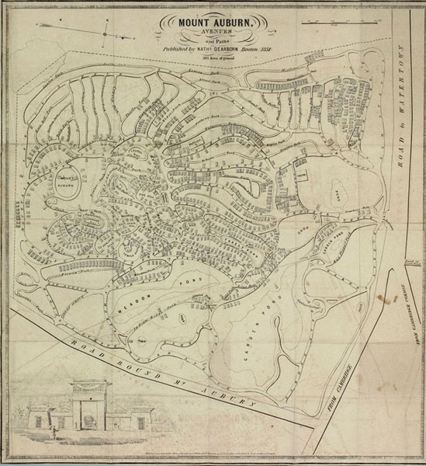
Frontispiece to Dearborn’s Guide through Mount Auburn (1851).
Mount Auburn, America’s first “rural” cemetery, opened in 1831. Carved out of a farmer’s woods in Cambridge and Watertown, Massachusetts, it received initial support from the Massachusetts Horticultural Society, which hoped to run an experimental garden there.

Slide 6
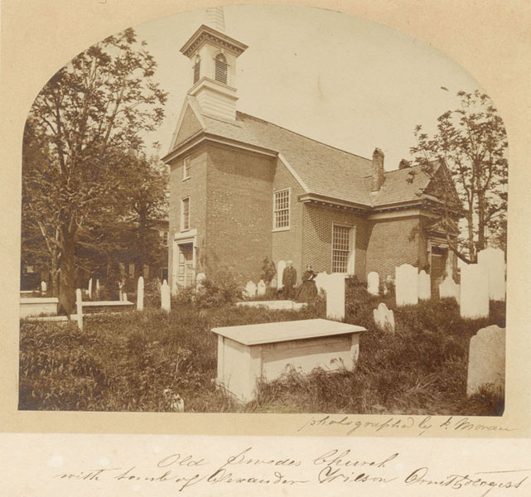
John Moran, photographer. View of Gloria Dei Church. Philadelphia, ca. 1862. Gift of John A. McAllister.
Home to a Swedish Lutheran congregation from 1700 until 1845, Gloria Dei (or “Old Swedes’”) buried dues-paying churchgoers and others whose friends or relatives made a good case. But freethinking (or truant) members of Old Swedes’ were among the first to establish an alternative: the Mutual Family Burial Ground Association (est. 1826).

Slide 7
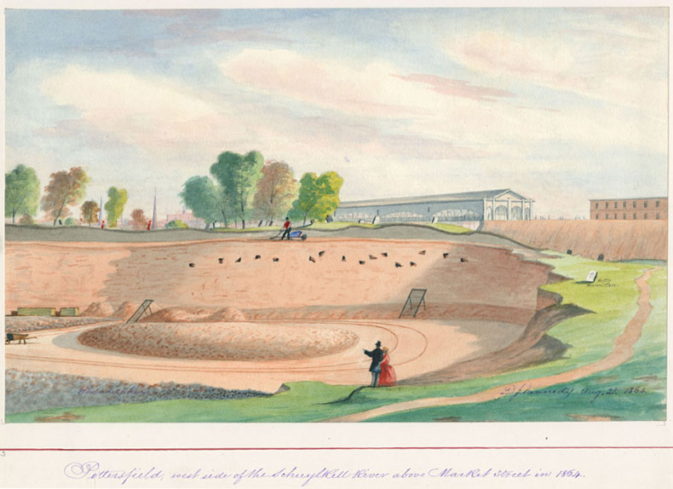
D. J. Kennedy, artist. Pottersfield, West Side of Schuylkill River above Market Street in 1864. Watercolor. The Historical Society of Pennsylvania.
Several vacant lots served Philadelphia as unofficial potter's fields before 1850. The fate of this one – dug up to build 30th Street Station's predecessor – mirrored that of many older urban graveyards.

Slide 8
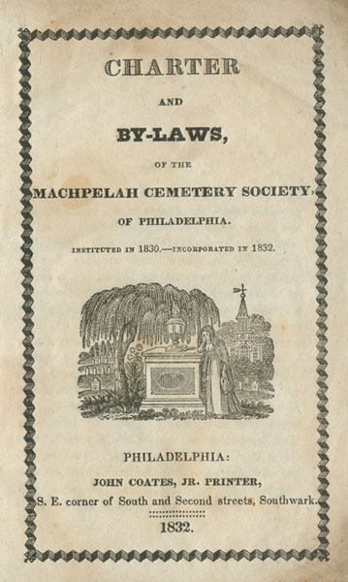
Machpelah Cemetery. Charter and By-Laws. Philadelphia, 1832. The Historical Society of Pennsylvania.
Machpelah was one of Philadelphia’s early “associate” cemeteries. The novelty of these non-sectarian institutions was blunted by their organizers’ use of religious iconography and biblical nomenclature; (“Machpelah” refers to the plot of land the patriarch Abraham purchased for his wife Sarah’s burial, as described in the book of Genesis).

Slide 9
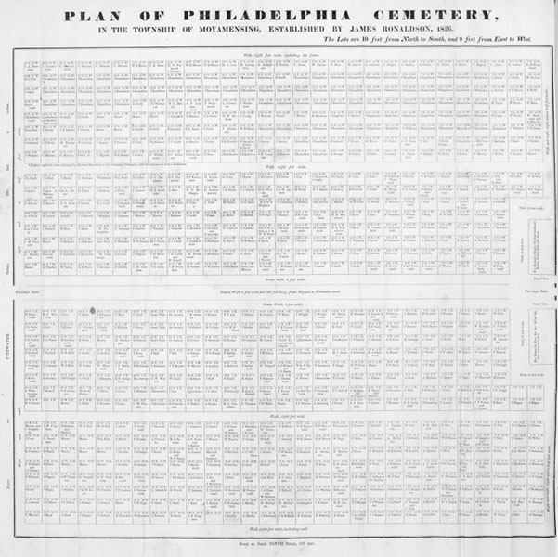
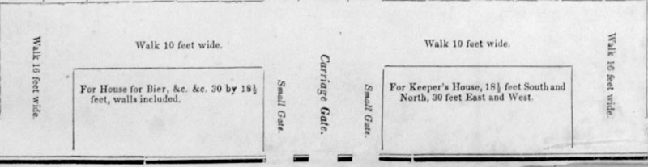
Philadelphia Cemetery (1845). Frontispiece.
Laurel Hill was as entrepreneurial as it was philanthropic. In this respect, it differed from most American burial grounds but not from Philadelphia Cemetery, established by typefounder and venture capitalist James Ronaldson in 1827. Ronaldson's gatehouse contained a bier and bell for detecting life in the soon-to-be-buried corpse.

Slide 10
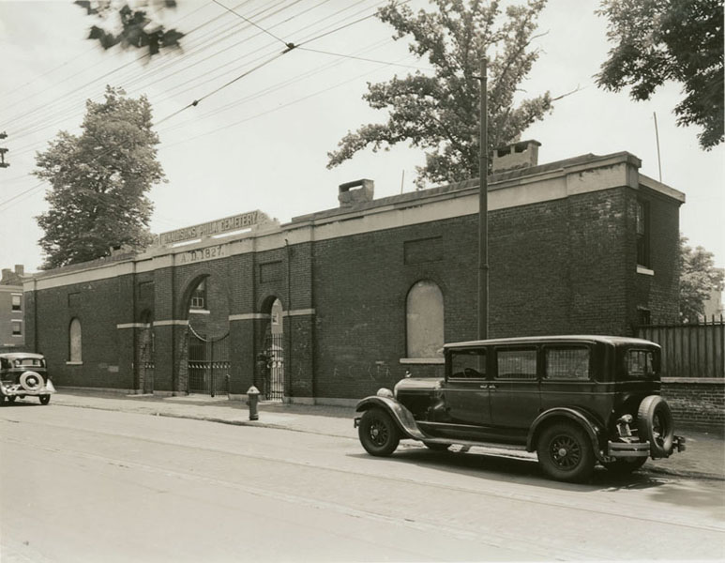
Philadelphia Cemetery Gatehouse (ca. 1940). The Historical Society of Pennsylvania.

Slide 11
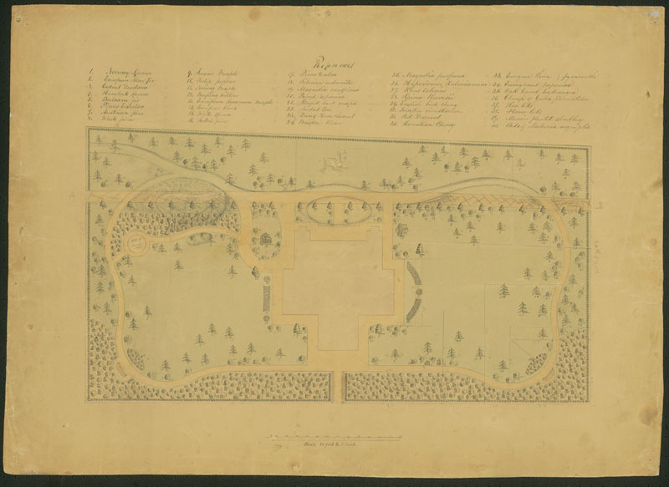
Landscape Plan for the Preston Retreat. Attributed to John McArthur. Pennsylvania Hospital Archives (on long-term loan to the Athenaeum of Philadelphia through The Pew Charitable Trusts Museum Loan Program).
Serenity, sanitation, and seclusion: these were goals Laurel Hill shared with institutions like the Preston Retreat (est. 1837), a lying-in hospital for “indigent married women, of good character.” Both establishments had Quaker ties. Both featured landscaped, arboretum-like grounds – a melding of art and science that might be labeled the therapeutic picturesque.

Slide 12
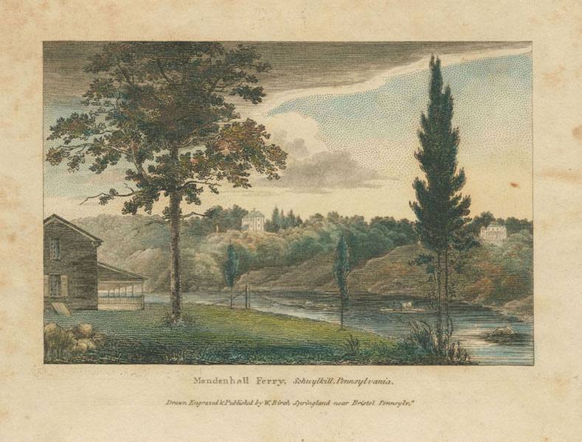
William Russell Birch, artist and engraver. Mendenhall Ferry, Schuylkill, Pennsylvania (1809). Gift of Mrs. S. Marguerite Brenner.
Birch captures Joseph Sims’s villa (center-left) from the southwest and shows the dramatic river views it commanded. To the right is lawyer William Rawle’s Harleigh. Such retreats represented the height of fashionable ease in Early National Philadelphia.

Slide 13
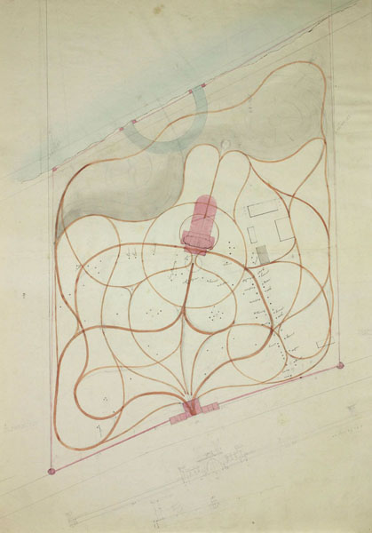
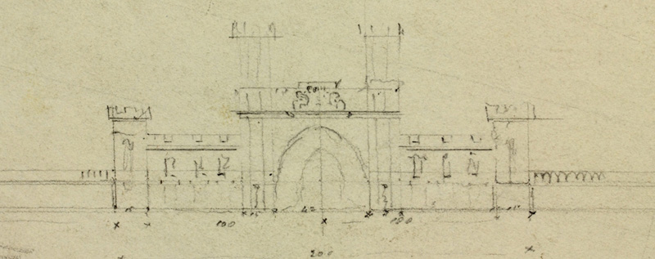
Plan of Laurel Hill Cemetery. Attributed to Thomas Ustick Walter.
Detail from Plan of Laurel Hill Cemetery
This snaking plan for Laurel Hill is traditionally if problematically attributed to Thomas Ustick Walter. Based on the same survey map as William Strickland's proposal, it prefigures the final design more closely. Note, too, that the sketch depicting an unexecuted Gothic scheme for Laurel Hill's entrance suggests the strong possibility that Henry Edward Kendall's Sketches of the Approved Designs (1832) influenced the thinking of Laurel Hill's designers.

Slide 14
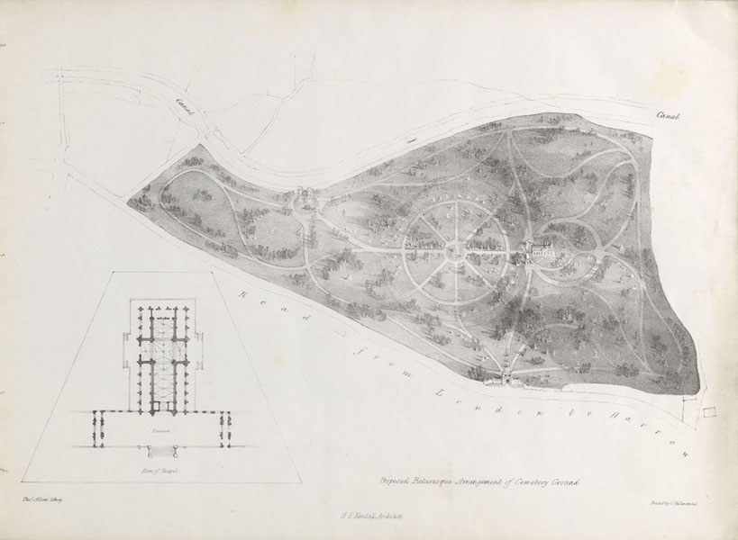
Henry Edward Kendall. Sketches of the Approved Designs of a Chapel and Gateway Entrances Intended to Be Erected at Kensall Green for the General Cemetery Company. London: J. Williams, 1832. The Yale Center for British Art.

Slide 15
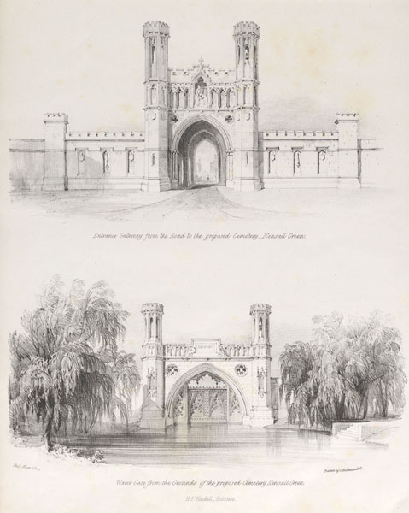
Henry Edward Kendall. Sketches of the Approved Designs of a Chapel and Gateway Entrances Intended to Be Erected at Kensall Green for the General Cemetery Company. London: J. Williams, 1832. The Yale Center for British Art.
Historians suggest that this work – and especially these plates – influenced the design of Laurel Hill. Kensal Green was London's preeminent garden cemetery. H. E. Kendall's semi-geometrical ground plan and (unexecuted) Gothic chapel may have inspired their Philadelphia counterparts.

Slide 16
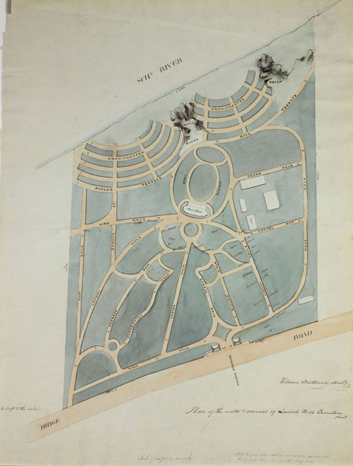
William Strickland, architect. Plan of the Walks and Avenues of Laurel Hill Cemetery (1836).

Slide 17
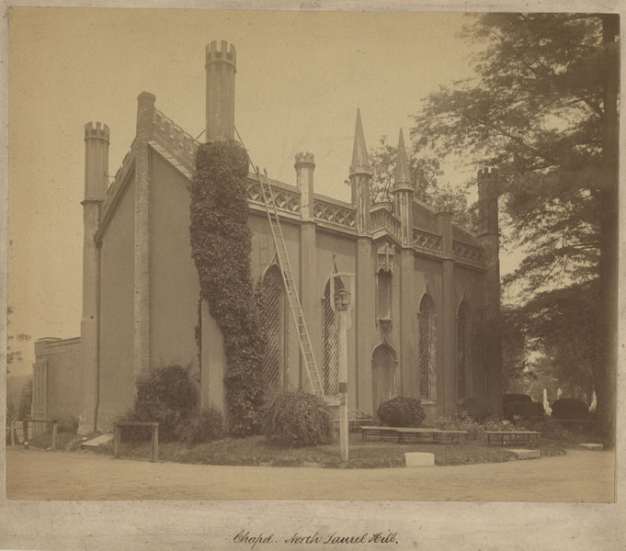
Chapel, North Laurel Hill (ca. 1880). Laurel Hill Cemetery.
John Notman's crenellated chapel was an early example of (quasi) ecclesiastical Gothic Revival architecture in America and gave the grounds some resemblance to an English churchyard. The building was demolished in the 1880s, shortly after this photo was taken.

Slide 18
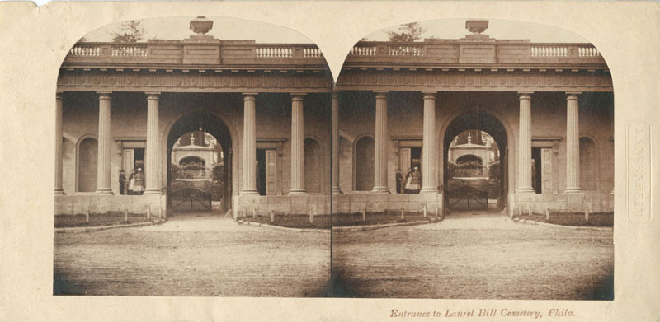
W. & F. Langenheim, photographer. Entrance to Laurel Hill Cemetery, Phila. (ca. 1860). Gift of John A. McAllister.
With assistance from Thomas U. Walter, John Notman designed the triumphal arch that served as Laurel Hill's public face (see also Hammond engraving above). A vaulted passageway separated two caretakers' lodges and provided a dramatic approach to Thom's sculpture group.

Slide 19
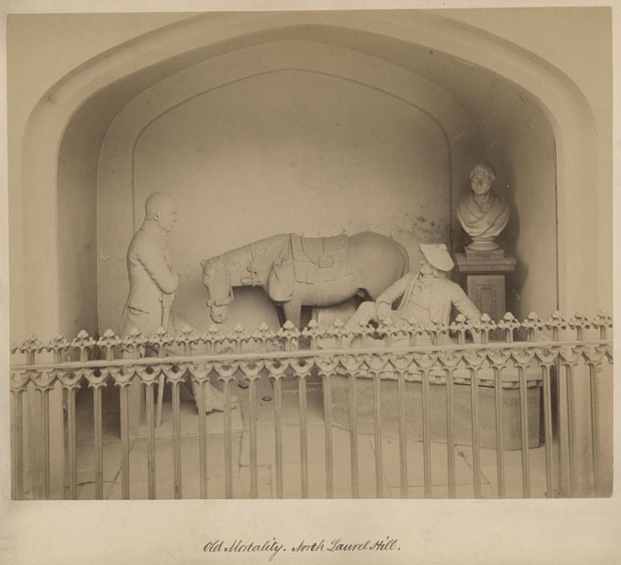
Old Mortality, North Laurel Hill. Laurel Hill Cemetery.
In Sir Walter Scott's tale, Old Mortality, the eponymous hero travels the Scottish countryside on horseback, preserving the memories of Presbyterian martyrs by re-carving the inscriptions on their gravestones. Connecting this mission with their own, Laurel Hill's founders bought these sculptures of horse, recumbent rider, and author, when their maker, James Thom, came to town. (The bust is a later addition, depicting Thom himself).

Slide 20
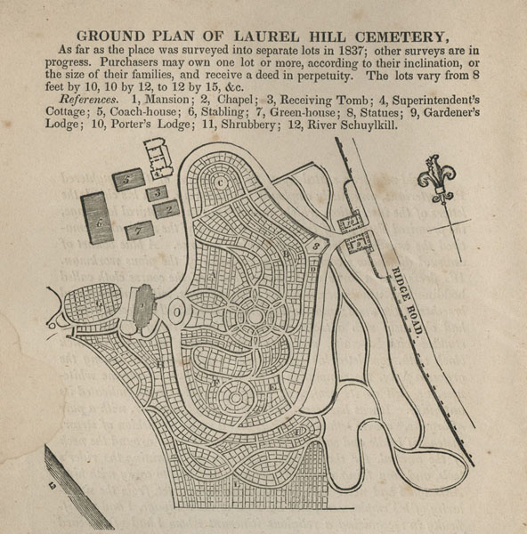
Plan for Laurel Hill Cemetery in Statues of Old Mortality and His Pony, and of Sir Walter Scott (1838). Laurel Hill Cemetery.

Slide 21
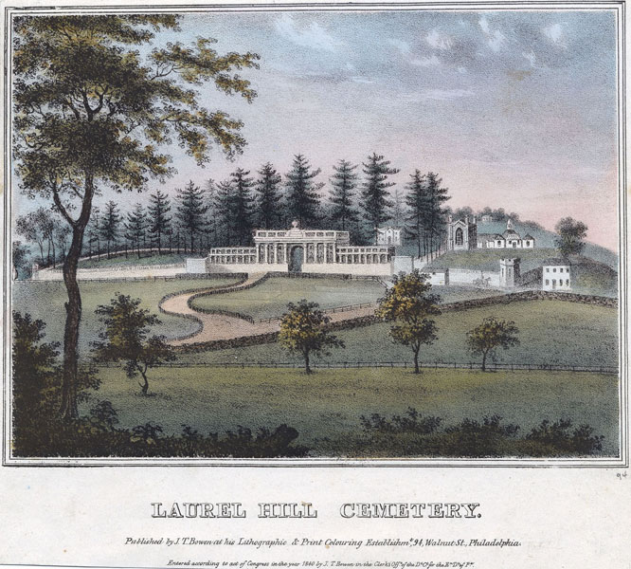
John Caspar Wild, lithographer. Laurel Hill Cemetery, Philadelphia. Philadelphia: J. T. Bowen, 1848.
Screens of evergreens on Laurel Hill’s borders enhanced the site’s sense of seclusion. According to horticulturists and moralists, such trees befitted a rural cemetery because they suggested eternal life. Joseph Sims’s soon-to-be-demolished villa peeks through an opening to the right of the gatehouse.

Slide 22
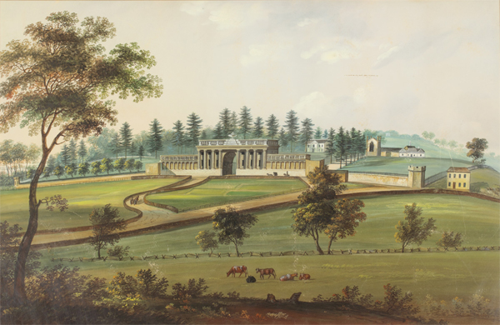
John Caspar Wild, artist. Laurel Hill Cemetery, Philadelphia, (ca. 1838). From the collection of David Doret.
This handsome rendering likely served as Wild’s study for the lithograph that appeared as plate 20 in his Views of Philadelphia and its Vicinity, published in 1838, and subsequently reissued [see 4.07b]. Larger and more bucolic than the published version, it is in some respects less accurate; (note, for instance, the omission of lancet windows from the right corner tower). However, the depictions of the Sims mansion, immediately to the right of the entrance, and of the rectangular planting beds in the foreground supply details missing in all other known views.

Slide 23
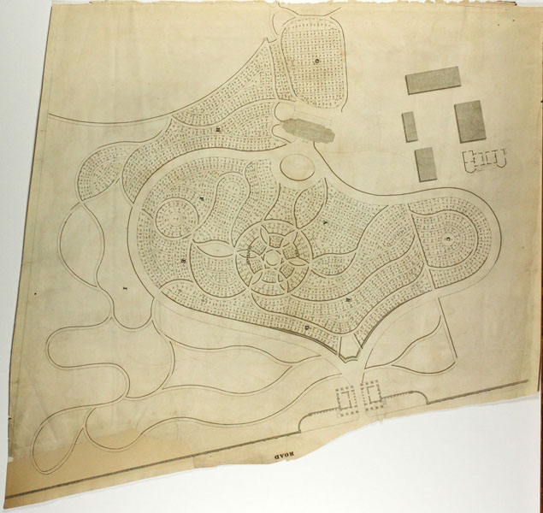
John Hammond. Plan of the Laurel Hill Cemetery, near Philadelphia (ca. 1845).
Responsibility for subdividing the original 20-acre parcel fell largely to Philip M. Price (1802-1870). A veteran surveyor of urban real estate – he laid out much of Philadelphia's Spring Garden district – he may fairly be credited as an author of Laurel Hill's plan. Like its local, grid-based predecessors, the cemetery was compact. Indeed, a careful observer might have noticed a familiar pattern: lots backed up to each other in double rows, the recipe for a standard city block.

Slide 24
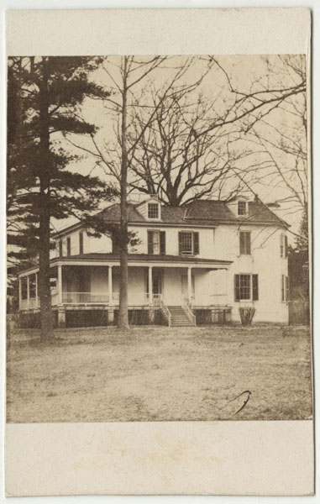
Fairy Hill. Laurel Hill Cemetery.
Fairy Hill, also known as Fancy Hill, served as the retreat of patrician George Pepper from 1813 until 1846. In the early 1860s, John Jay Smith and his colleagues leapt at the opportunity to unite the two Laurel Hill Cemeteries by creating a third one on this site. The house came down soon afterward.

Slide 25
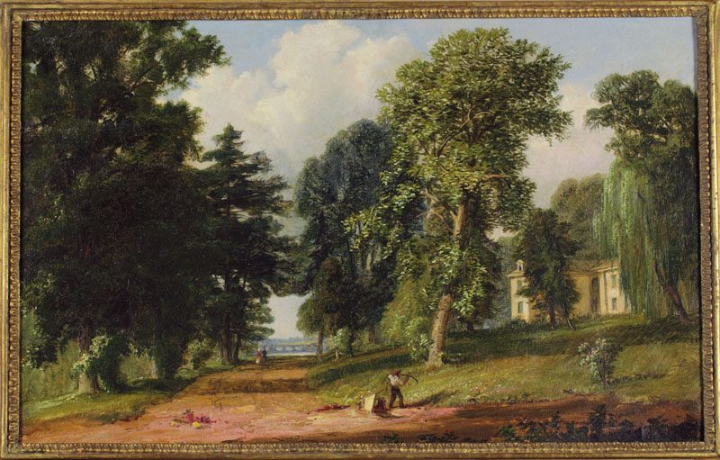
Russell Smith, artist. Fairy Hill near Laurel Hill (1862). On loan from a private collection.
Russell Smith's view captures one world's imminent displacement by another. The aging Fairy Hill estate appears on the right. Acquired a year earlier by the Laurel Hill Cemetery Company, it will vanish in a matter of months, making it possible to unite the north and south sections of the cemetery. In the distance, a couple strolls towards the cemetery's steamboat landing. Trees to their left cast long shadows without revealing what lies behind them: the monuments of South Laurel Hill.

Slide 26
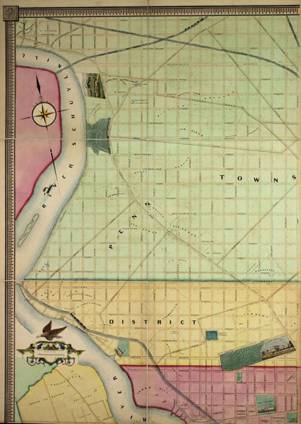
J. C. Sidney. Map of the City of Philadelphia Together with All the Surrounding Districts. Philadelphia: Smith & Wistar, 1849. Gift of Charles A. Poulson.
On paper if not yet on the ground, Philadelphia's street grid had reached Laurel Hill by mid century. This section of a much larger map features the earliest known depiction of South Laurel Hill, established in the same year. Civil engineer, cartographer, and aspiring architect James Charles Sidney (1818?-1881) was subtly advertising his skills: he conceived the new cemetery's plan and the map on which it appeared.

Slide 27
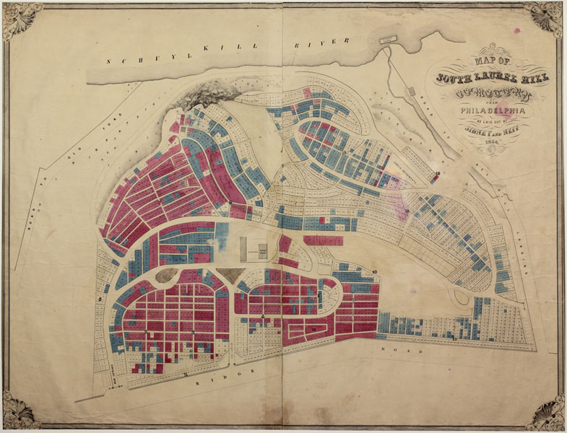
Sidney & Neff. Map of South Laurel Hill Cemetery (1854). Laurel Hill Cemetery.
Here J. C. Sidney, now in partnership with James P. W. Neff, presents his scheme for South Laurel Hill in detail. Some two-thirds of the former Harleigh estate had been surveyed into lots by this time. As in the older portion of the cemetery, provision was made for single graves (Sec. 15) and church lots (Sec. 13). The superintendent's quarters likely include the former country house of William Rawle.

Slide 28
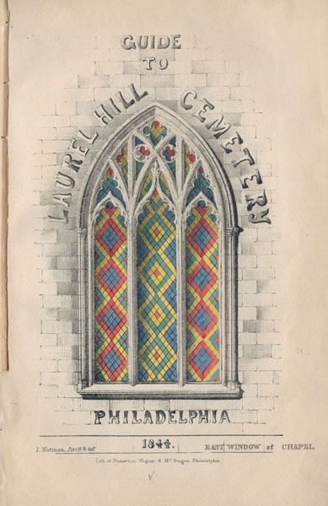
Guide to Laurel Hill Cemetery, near Philadelphia. Philadelphia, 1844.

Slide 29
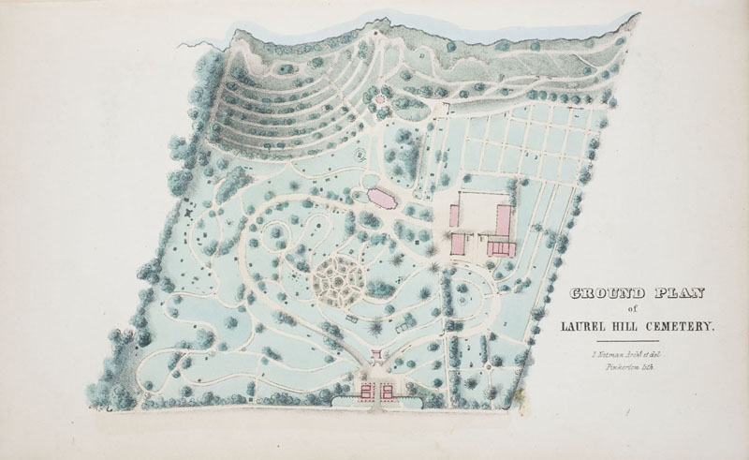
John Notman. “Ground Plan of Laurel Hill Cemetery,” from Guide to Laurel Hill Cemetery (1844). Laurel Hill Cemetery.

Slide 30
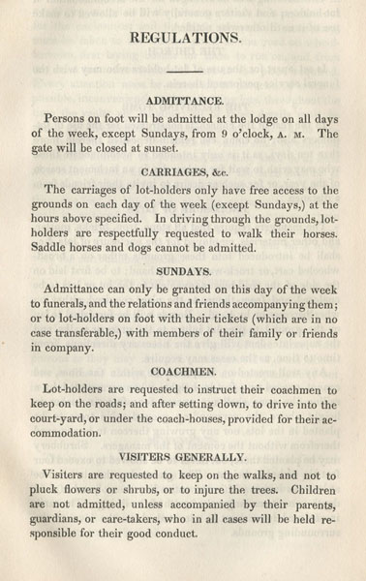
Regulations of the Laurel Hill Cemetery on the River Schuylkill near Philadelphia. Philadelphia: John C. Clark, 1839.
Laurel Hill’s printed rules grew more elaborate over time. Sunday access had initially been limited to funeral goers and lot-holders with company tickets. After 1847, visitors planning to arrive on other days needed tickets, too. Smith distributed these from his office at the Library Company and Frederick Brown from his drug store on Chestnut Street.

Slide 31
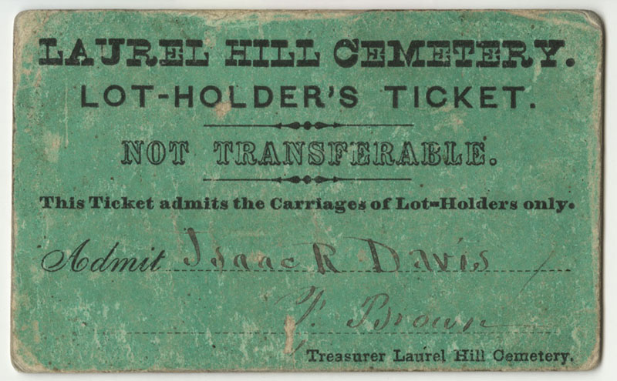
Laurel Hill Cemetery. Lot-holder's Ticket.

Slide 32
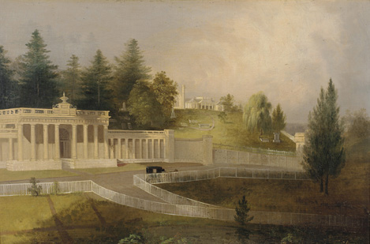
Laurel Hill Cemetery Gate, Philadelphia (ca. 1840). On loan from the Pennsylvania Academy of the Fine Arts. Gift of Mrs. Edgar P. Richardson.

Slide 33
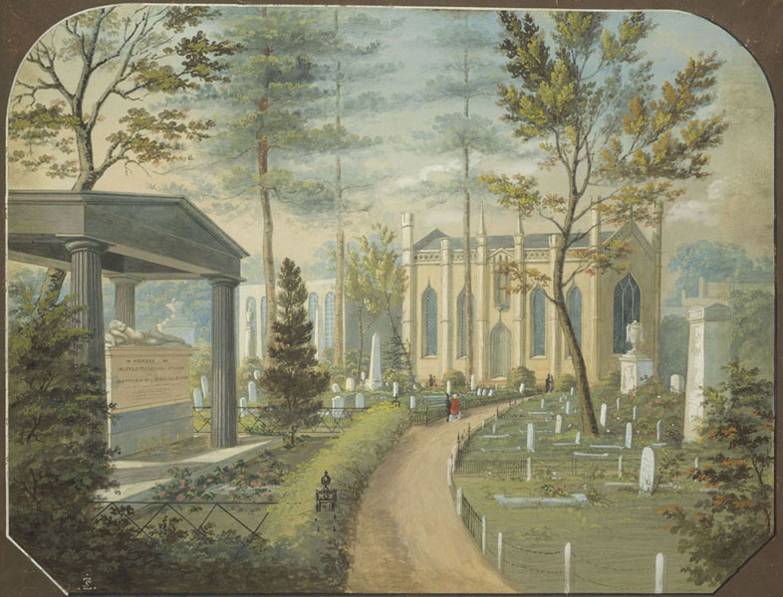
Antonio Zeno Shindler, artist. Laurel Hill Cemetery, Philadelphia (ca. 1850). The Museum of Fine Arts, Boston. Gift of Maxim Karolik.
Designed by architect William Strickland and executed by the firm of John Struthers and Son, the Alfred Miller tomb and its meticulously planted lot occupy the foreground of this painting. In the distance, the cemetery's first greenhouse appears behind an evergreen. This is the only known depiction of the building, which had originally been part of Joseph Sims's estate.

Slide 34
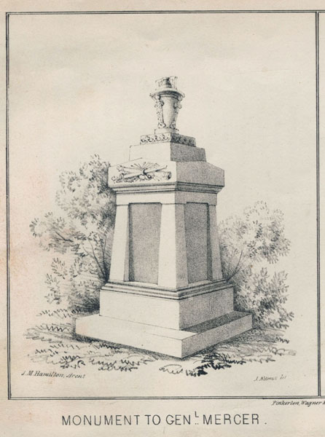
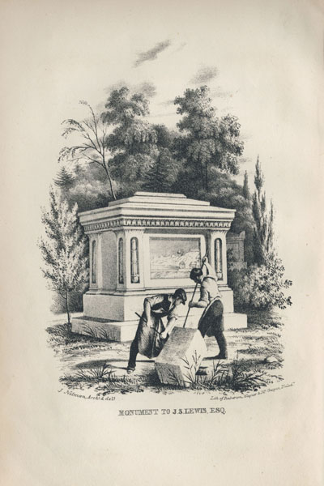
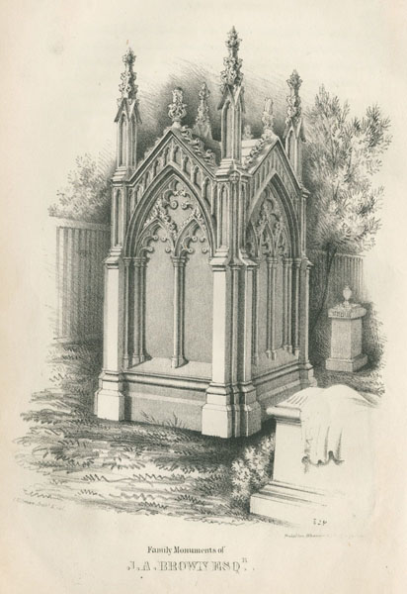
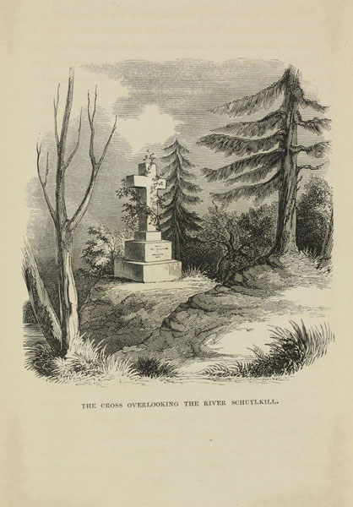
Monuments in Laurel Hill Cemetery, from Guide to Laurel Hill Cemetery (1844).
Against the homogenizing spread of obelisks, Smith drew visitors’ attention to complex, custom-made designs shaped by history, biography, and sentiment. John Notman’s Gothic tomb for John A. Brown bespoke family cohesion. The Egyptian sarcophagus of Joseph Lewis (also by Notman) used a bas-relief of the Waterworks to recall the deceased’s role in that project. Scabbard and cannon announced Mercer as a war hero. And, near the end of the recommended tour route, visitors were told to look for “a stone cross, partially covered with vines, on a point of rock.” This scene exemplified the fusion of Christianity and nature worship that pervaded the cemetery as a whole.

Slide 35
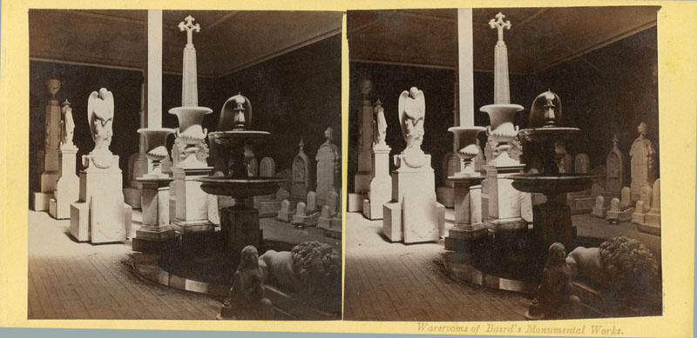
John Moran, photographer. Warerooms of Baird's Monumental Works (ca. 1864).
John Baird ran the largest marble yard in Spring Garden and, perhaps, in the nation during the middle of the 19th century. His outfit made early use of steam saws and reputedly consumed 15,000 cubic feet of Italian marble a year. (See also Baird's broadside advertisement below).

Slide 36
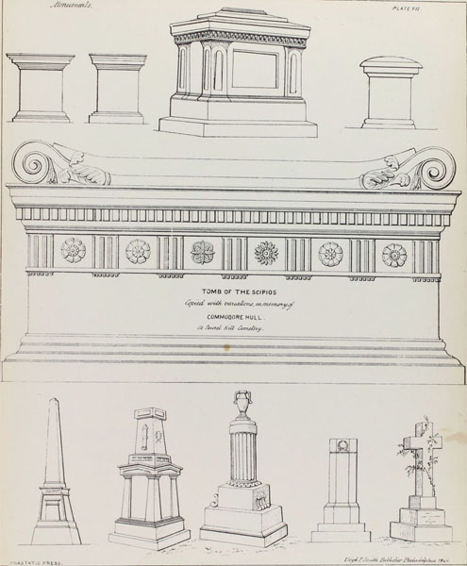
John Jay Smith and Thomas Ustick Walter. A Guide to Workers in Metals and Stone. Philadelphia: Carey and Hart, 1846.
Smith handily recycled designs from Laurel Hill’s 1844 Guide in this cheaply printed pattern book. Most prominent are the tombs of Joseph Lewis (top) and Isaac Hull, both executed by the Struthers firm. Below them are monuments to William Birch and Oscar Douglas (second and third from left) designed by an architect – John M. Hamilton – who listed himself at the Struthers’ business address in the late 1840s.

Slide 37
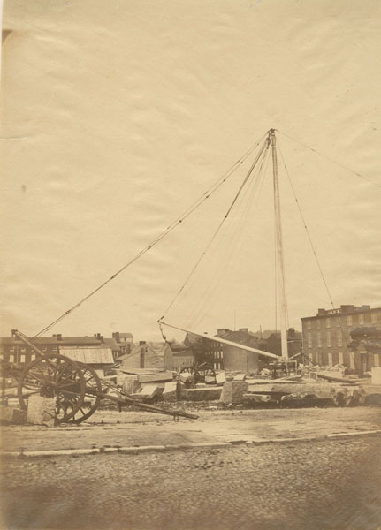
James E. McClees, photographer. J. Struthers & Son Marble Yard (1858). Gift of John A. McAllister.
Using a jib crane, Struthers employees sent off marble blocks to be carved into monuments or dressed into building materials. John Struthers’ son, William, ran the 42-year-old concern by this time.

Slide 38
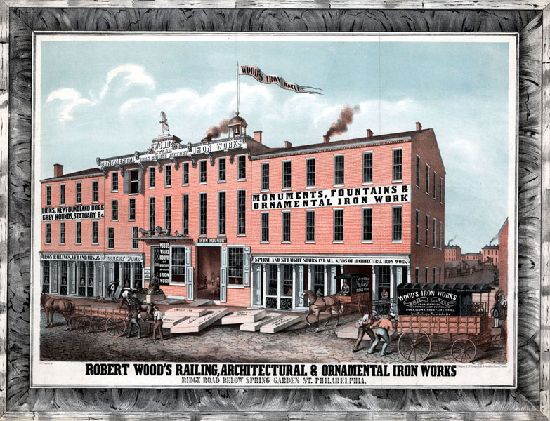
Robert F. Reynolds, artist. Robert Wood’s Railing, Architectural & Ornamental Iron Works. Philadelphia: Wagner & McGuigan, ca. 1851.
Wood’s firm supplied the most sculptural and ornate ironwork on Laurel Hill lots at mid-century. (See also broadside advertisements below).

Slide 39
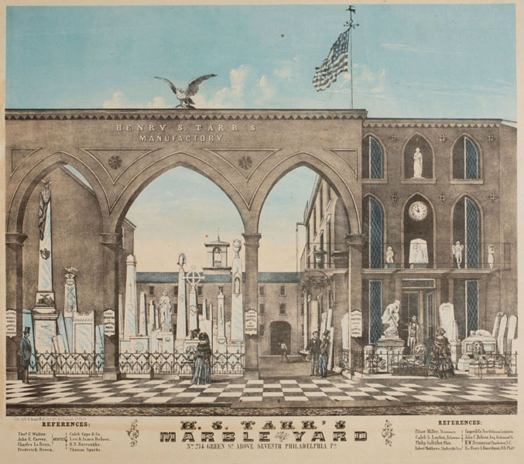
W. H. Reese, lithographer. H. S. Tarr’s Marble Yard. Philadelphia, ca. 1858.
Tarr’s list of references includes architect and Laurel Hill friend Thomas U. Walter as well as cemetery manager Frederick Brown.

Slide 40
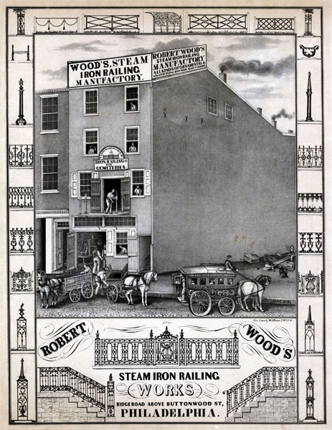
W.H. Rease, lithographer. Robert Wood's Steam Iron Railing Works. Philadelphia, 1847.

Slide 41
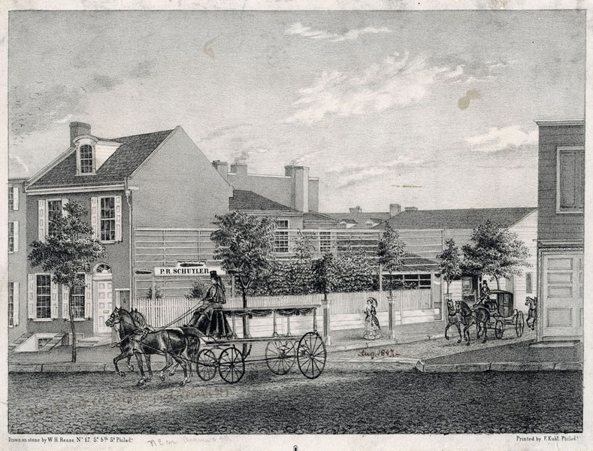
W. H. Rease, lithographer. P. R. Schuyler, Furnishing Undertaker. Philadelphia: F. Kuhl, ca. 1848.

Slide 42
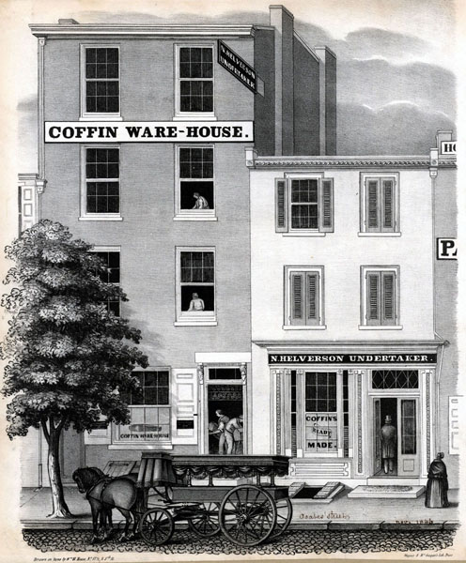
W. H. Rease, lithographer. N. Helverson Undertaker. Philadelphia: Wagner & McGuigan, 1846.
Unlike the up-market Schuyler, Helverson specialized in ready-made coffins. Most but not all of Laurel Hill’s customers would have considered such discount goods beneath them.

Slide 43
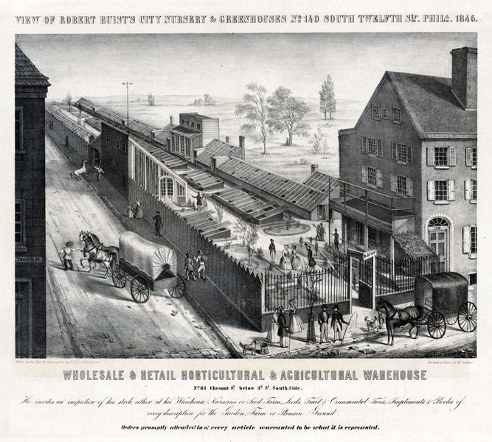
Alfred M. Hoffy, lithographer. View of Robert Buist’s City Nursery & Greenhouses. Philadelphia: Wagner & McGuigan, 1846.
Nationally known nurseryman Robert Buist sold plants to Laurel Hill’s managers and customers.

Slide 44
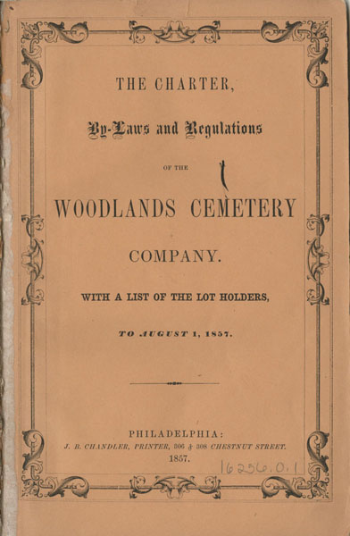
The Charter, By-laws and Regulations of the Woodlands Cemetery Company. Philadelphia: James B. Chandler, 1857.

Slide 45
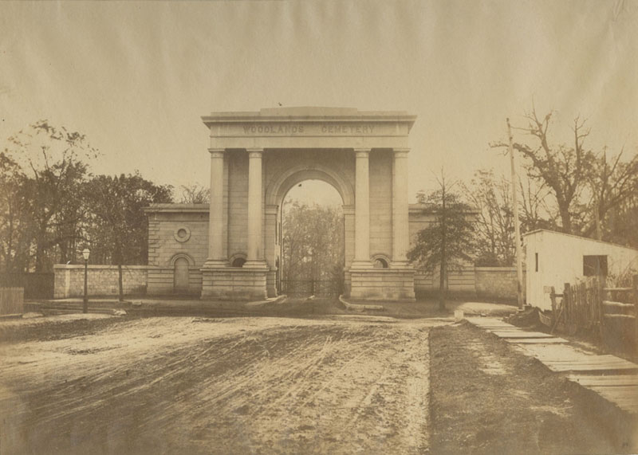
James E. McClees, photographer. Entrance to Woodlands Cemetery (1858).
Re-purposing the estate of William Hamilton, Woodlands Cemetery was Laurel Hill’s most direct imitator and competitor. Surveyor Philip M. Price was one of its designers and founders. Architect John McArthur Jr., who had conceived South Laurel Hill’s entrance, performed the same service at Woodlands in the late 1850s.

Slide 46

Regulations of the Mount Vernon Cemetery Company. Philadelphia: T. K. and P. G. Collins, 1856.
The drift of people with business ties to Laurel Hill continued at Mount Vernon. John Notman designed the fanciful marble entrance and plantsman Robert Buist was the treasurer.

Slide 47

Plan for Mount Vernon Cemetery in Regulations of the Mount Vernon Cemetery Company (1856).
The plan of Mount Vernon Cemetery bore more than a passing resemblance to nearby Laurel Hill’s. Surveyor Griffith M. Hopkins was working at South Laurel Hill in the same period. He would later lay out Central and West Laurel Hills.

Slide 48

Rules and Regulations, and Description of West Laurel Hill Cemetery. Philadelphia, 1882.
The extension of Fairmount Park in the late 1860s ended managers’ hopes of expanding the original Laurel Hill Cemetery. By then, however, John Jay Smith knew the formula: establish another cemetery of the same name. West Laurel Hill took shape on the opposite side of the Schuylkill beginning in 1869. It benefitted both from associating with the older institution (to the annoyance of other managers there) and from novel access by steam train.

Slide 49

Map of West Laurel Hill Cemetery, from Atlas of the County of Montgomery and the State of Pennsylvania. Philadelphia: Griffith Morgan Hopkins, 1871. The Burlington Smiths.
West Laurel Hill’s design looked forward and backward. Laid out to handle “funerals by rail,” the site received the gently curving drives, circular islands, and rolling expanses that characterized post-bellum “landscape lawn” cemeteries. But the earliest sections resembled Central Laurel Hill (surveyor-cartographer Griffith M. Hopkins was the link). And sections not named for elite suburbs nodded instead to famous Schuylkill River villas.

Slide 50

Aero Service Corp. Aerial View of North and Central Laurel Hill Cemetery (ca. 1927). Laurel Hill Cemetery.
Using technology developed to plan WWI bombing raids, these panoramic aerial views show how built-up Laurel Hill had become by the onset of the Great Depression. As foliage decreased, gridded paths and lot divisions became more apparent.

Slide 51

Aerial view of Laurel Hill Cemetery. Laurel Hill Cemetery.
Apparent in these smaller views are several businesses related to the cemetery’s operation. At the intersection of the tree-lined Hunting Park Avenue and Ridge Avenue, the company’s greenhouse complex suggests the extent to which lot gardening had become an “inside” concern. To the north, the shop and yard across from the cemetery’s main entrance are those of monument dealer Thomas Delahunty, long a neighborhood fixture.

Slide 52

Aerial view of Laurel Hill Cemetery. Laurel Hill Cemetery.
Apparent in these smaller views are several businesses related to the cemetery’s operation. At the intersection of the tree-lined Hunting Park Avenue and Ridge Avenue, the company’s greenhouse complex suggests the extent to which lot gardening had become an “inside” concern. To the north, the shop and yard across from the cemetery’s main entrance are those of monument dealer Thomas Delahunty, long a neighborhood fixture.

Slide 53

Disston Family Mausoleum (1915). Laurel Hill Cemetery.
As it developed in the late 19th century, the main axis of Central Laurel Hill became a corridor of stone. Statue-capped obelisks, ponderous sarcophagi, and granite enclosures typified high-end production of the era. But the freestanding granite mausoleum was perhaps most emblematic of all. Saw maker Henry Disston’s Francophile variant anticipated similar construction on nearby “Millionaire’s Row.”

Slide 54


Laurel Hill (ca. 1910). Laurel Hill Cemetery.
While Laurel Hill had always offered lots at a range of prices, the physical differences between the ends of the spectrum were more pronounced by 1900. Newer, less expensive lots generally clustered in low-lying areas.

Slide 55

Laurel Hill Cemetery: Special Care of Lots (1918). Laurel Hill Cemetery.
The shift to lot maintenance performed exclusively by the cemetery company was in keeping with national trends. It was not especially peaceful, however. When Laurel Hill’s managers moved to ban “outside gardeners” in 1913, a storm of protest followed from lot-holders. Their lawsuit ultimately failed.

